Slide 1

Worked example in SAS
Emilie Demard
Wednesday, July 16th
Citrus Research and Education Center
Lake Alfred, FL

Slide 2
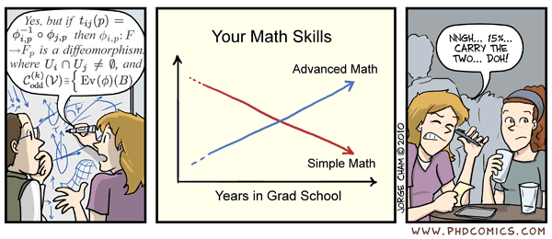
Steps for constructing and interpreting a GLMM
0. Data Exploration
Construct model
Fixed effects (predictor or explanatory variables)
Random effects (blocking variables)
Error distribution (response variable or dependent variable)
Assess residuals and overdispersion
Check random effects and/or distribution (not always needed)
Examine significance of terms in model
Anova
AIC model selection
Calculate treatment means and/or slopes
Construct contrasts
Calculate R2m and R2c
Make pretty figure

Slide 3
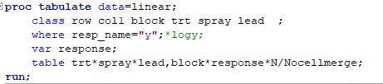
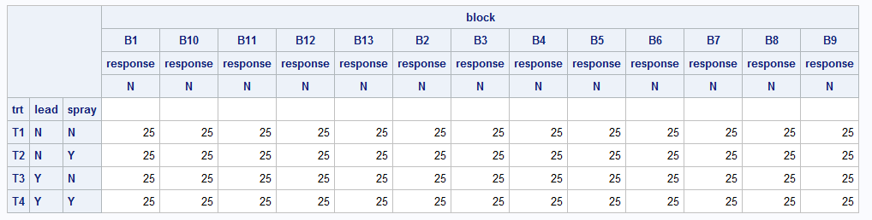
Intro: Data Carpentry
Checking experimental design (balanced/unbalanced, missing observation)

Slide 4
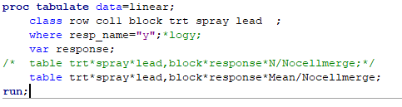
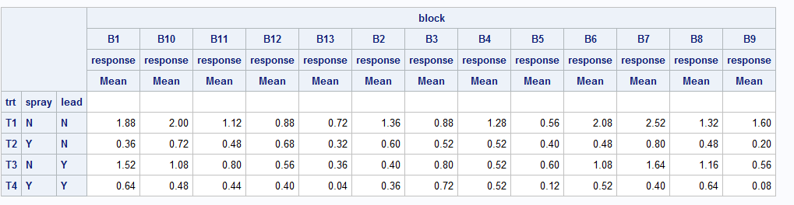
Intro: Data Carpentry
Checking for data entry error

Slide 5

Step 1: Setting up a basic model in SAS
log⁡(y_{ij}+1)=β₀+β₁(lead_{i}*spray_{j})+ε_{ij}
* is shorthand for (spray + lead + spray:lead)

Slide 6
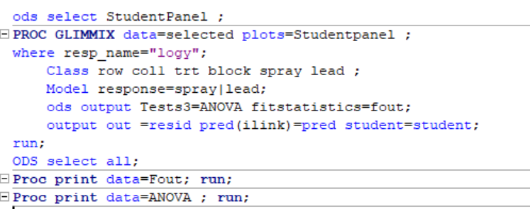
Step 1: Setting up a basic model in SAS

Slide 7

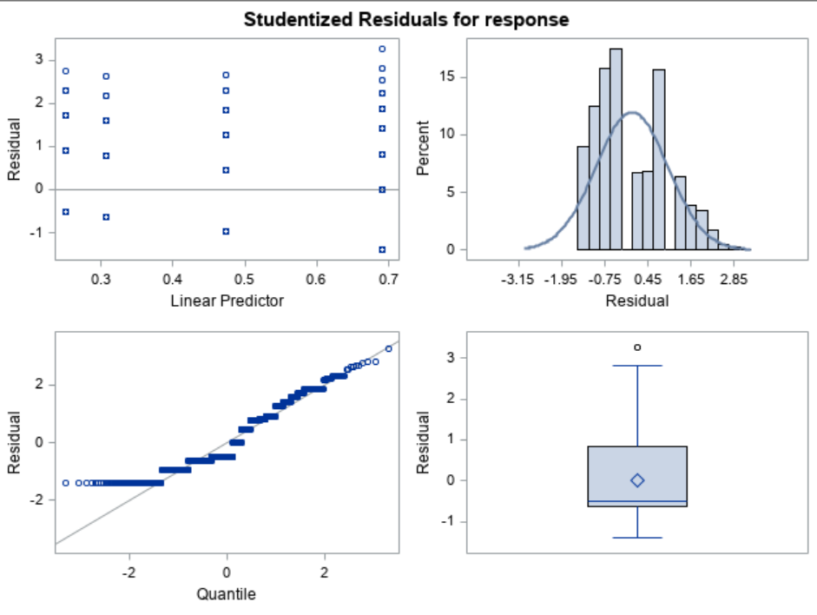
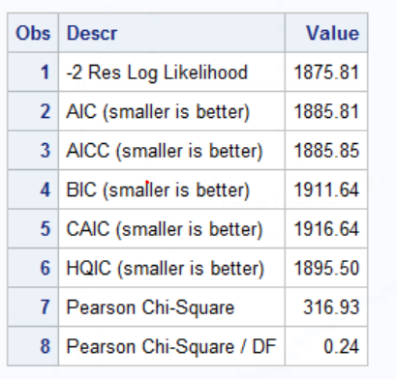
Step 2: Examine residuals

Slide 8
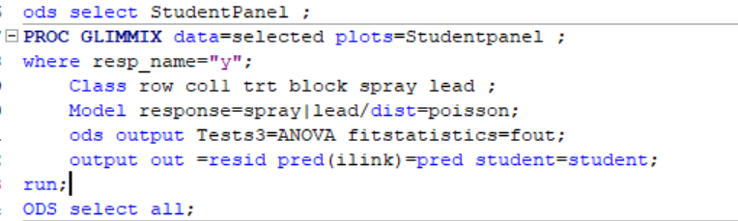
Step 1b. Setting up a GLM in R
log⁡(λ_{ij})=β₀+β₁(lead_{i}*spray_{j})
y_{ij} ~ Poisson(λ_{ij})

Slide 9
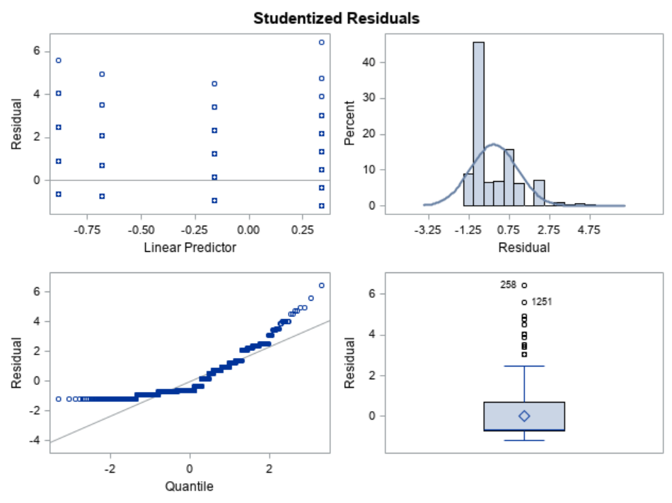
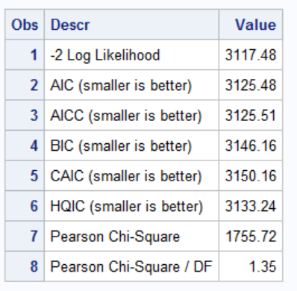
Step 2b. Check residues and overdispersion

Slide 10
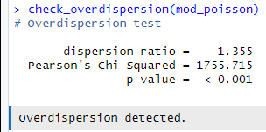
Step 2b. Check residues and overdispersion

Slide 11
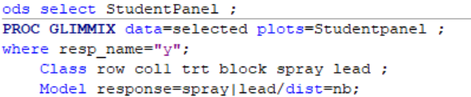
Step 1c. Update the GLM to correct overdispersion
log⁡(λ_{ij})=β₀+β₁(lead_{i}*spray_{j})
y_{ij} ~ Negative Binomial(μ_{ij}, φ _{ij})

Slide 12

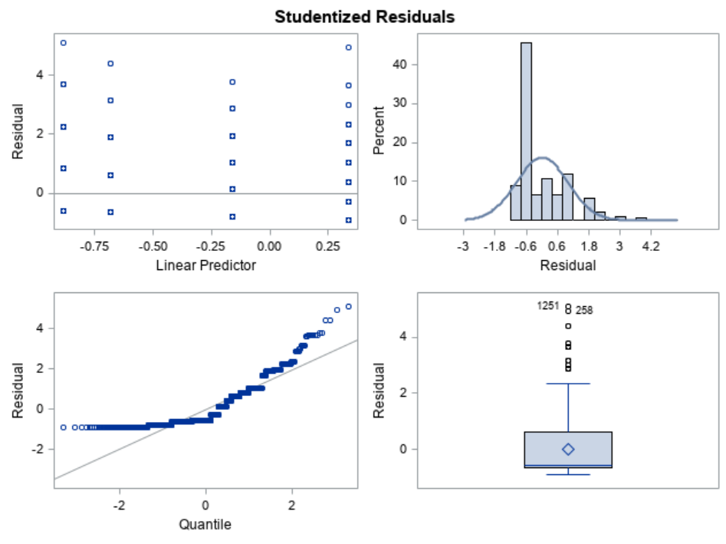
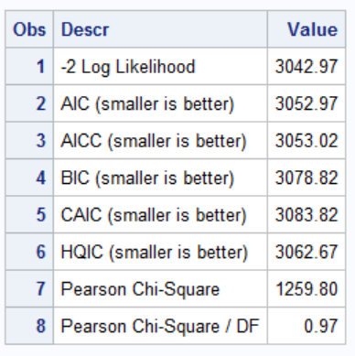
Step 2c. Check residues and overdispersion

Slide 13
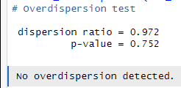
Step 2c. Check residues and overdispersion

Slide 14
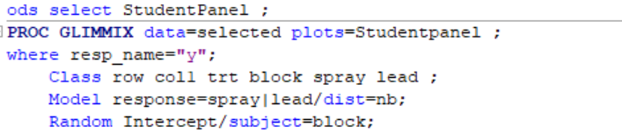
Step 1d. Update the GLM to correct overdisp.
log⁡(μ_{ijk}) = β₀ + β₁(lead_{i}*spray_{j}) + b_{k}
y_{ij} ~ Negative Bionomial(μ_{ij}, φ _{ij})

Slide 15
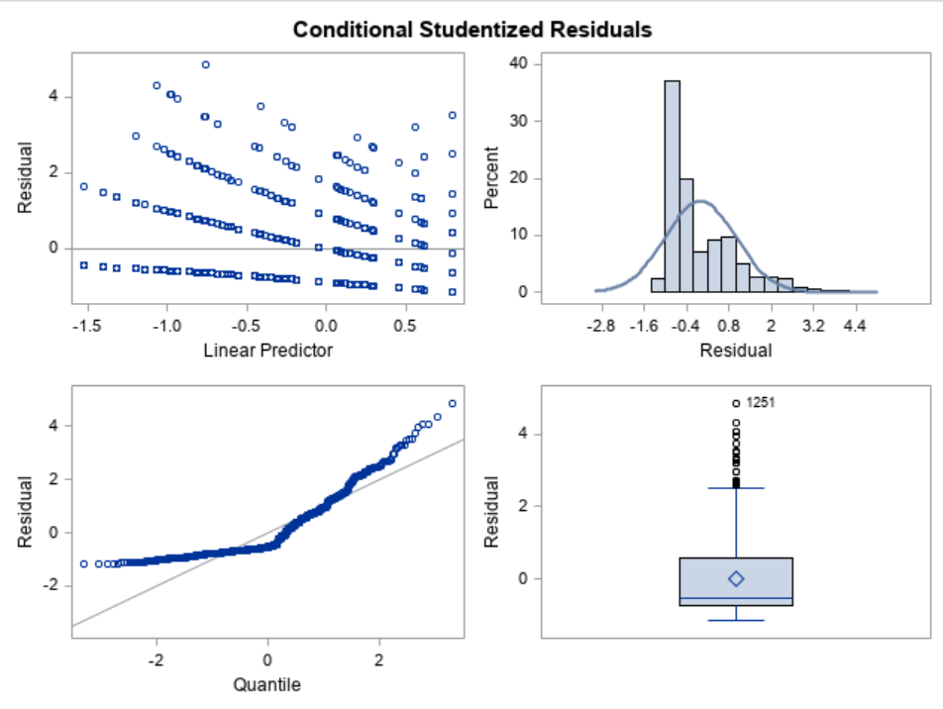
2d. Check residuals

Slide 16
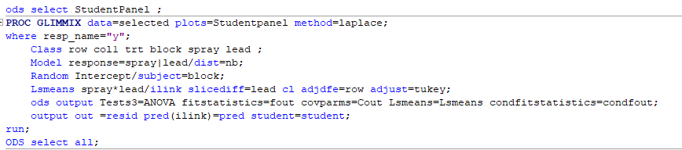
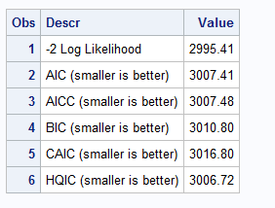
The block is good… but is it the best?
model df AIC
mod_nbinom 5 3052.969
mod_nbinom_blk 6 3007.412

Slide 17

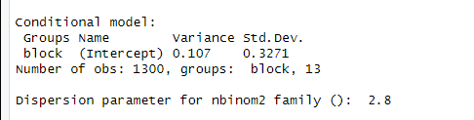
3. Check random effects and model basics
Dispersion parameter (θ)
Note: this in inverse of phi (φ):
φ = 1/ θ = 1/2.8 = 0.357

Slide 18
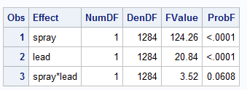
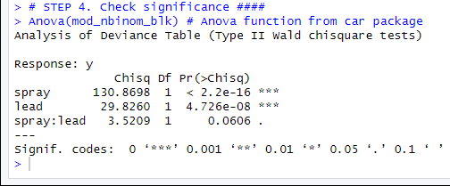
Step 4. Check significance

Slide 19
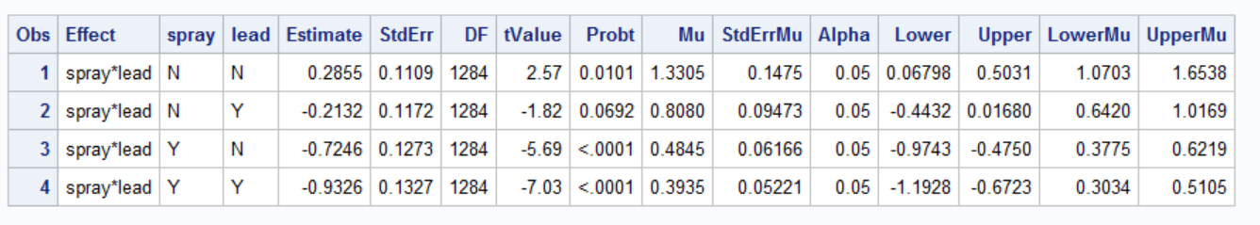
Step 5. Calculate treatment means
Parameter estimates back transform (datascale)
Parameter estimates on log-scale

Slide 20
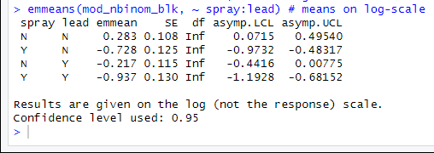
Step 5. Calculate treatment means
Parameter estimates on log-scale

Slide 21
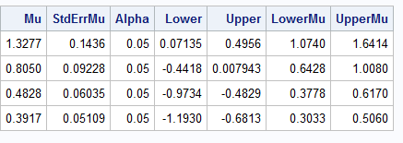
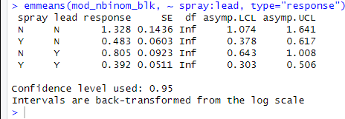
Step 5. Calculate treatment means (backtransformed)

Slide 22
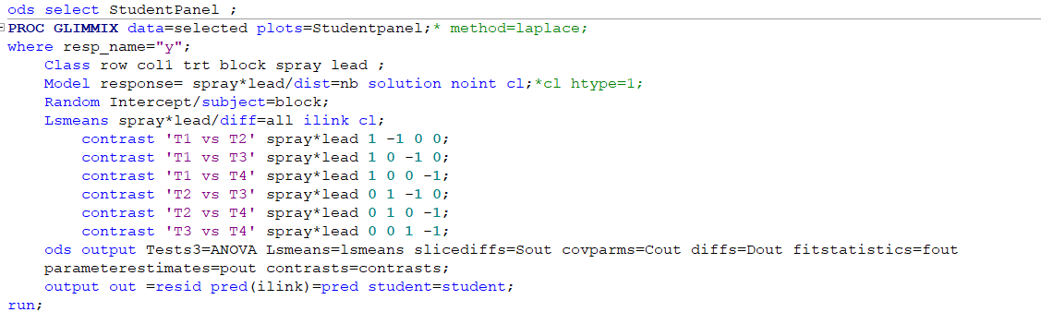
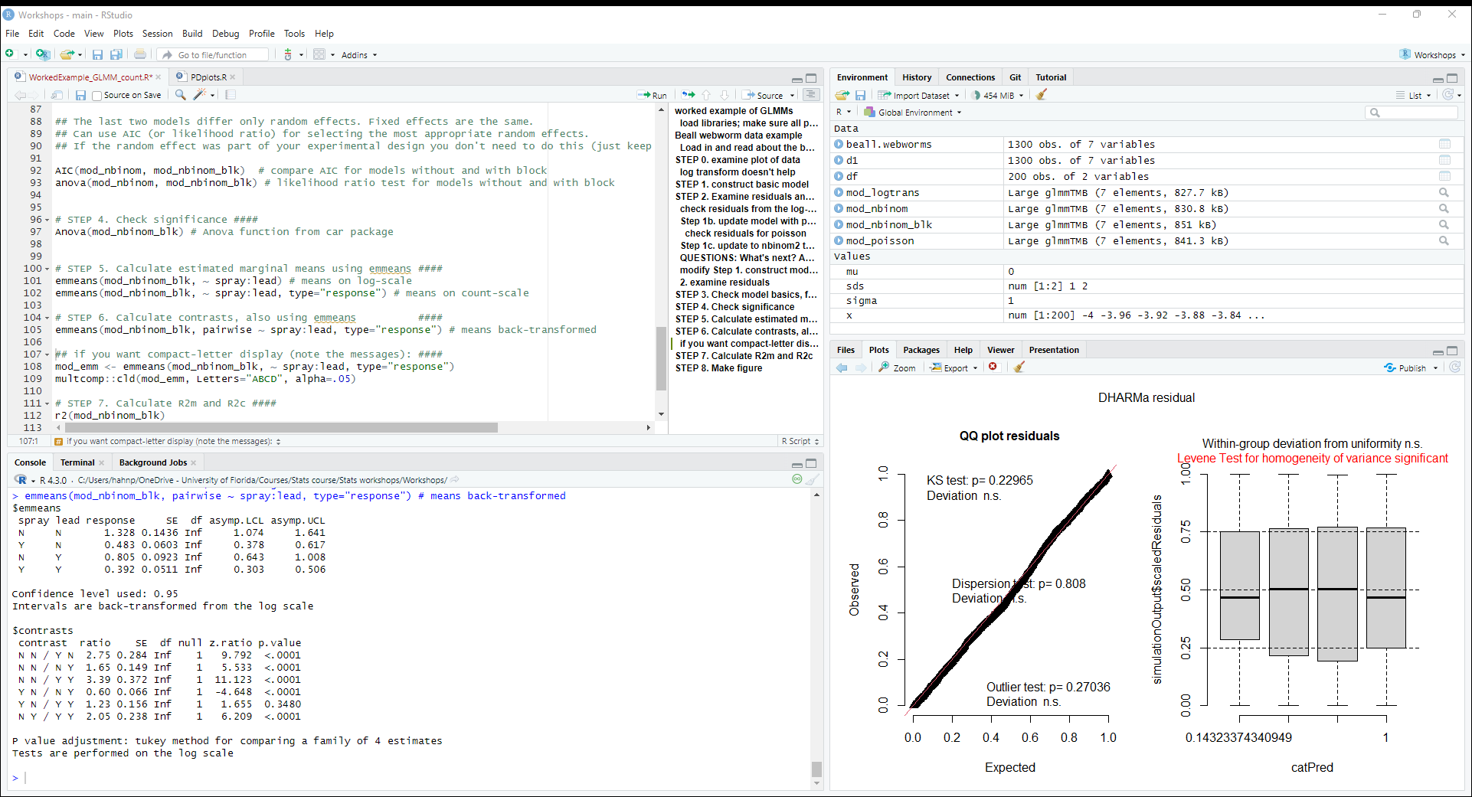
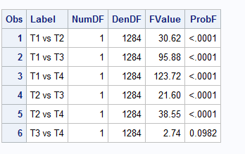
Step 6. Conduct contrasts

Slide 23
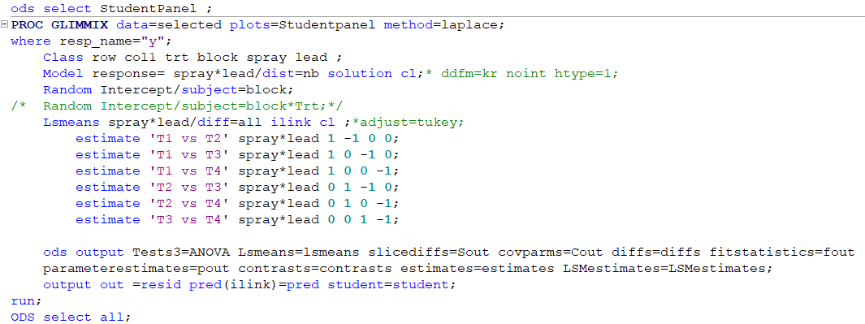
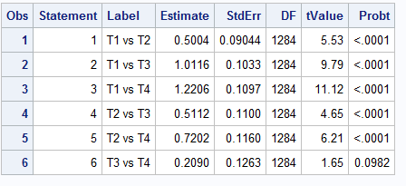
Step 6. Conduct contrasts

Slide 24
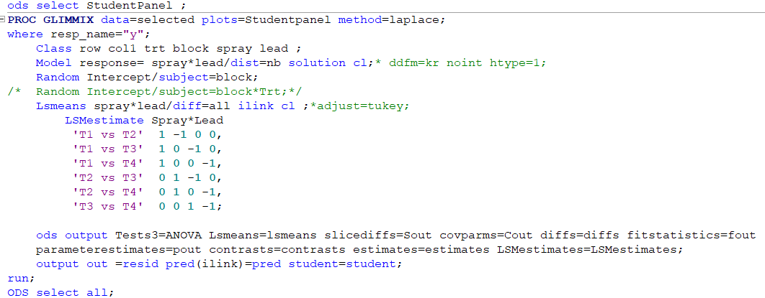
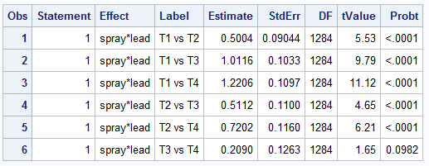
Step 6. Conduct contrasts

Slide 25
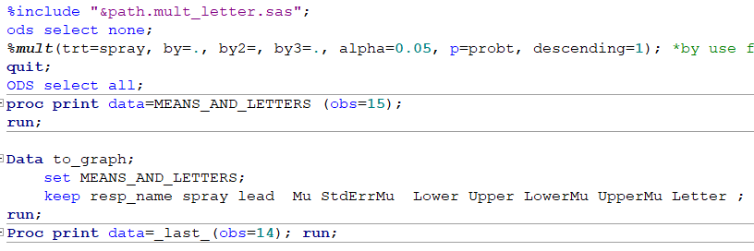
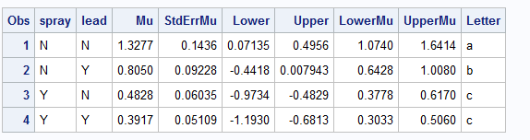
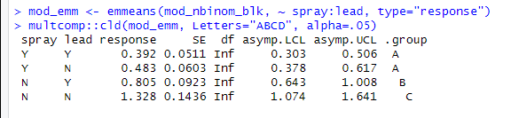
Step 6. Conduct contrasts - letters
Using the %mult macro to add letters

Slide 26
7. Calculate R2m and R2c
To come soon!
See Nakagawa et al. paper.
Notes:
R pairwise

Slide 27
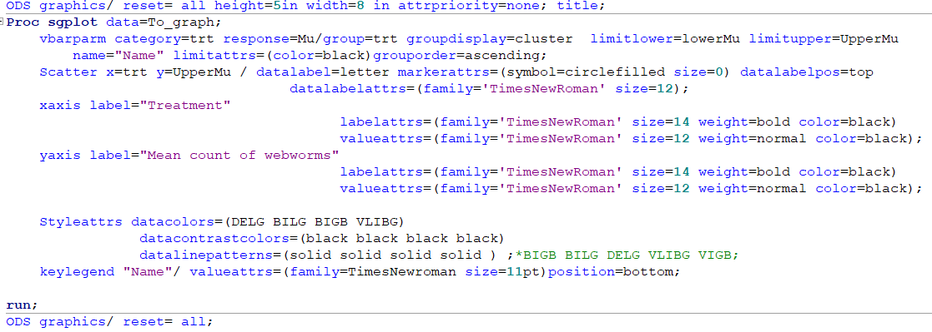
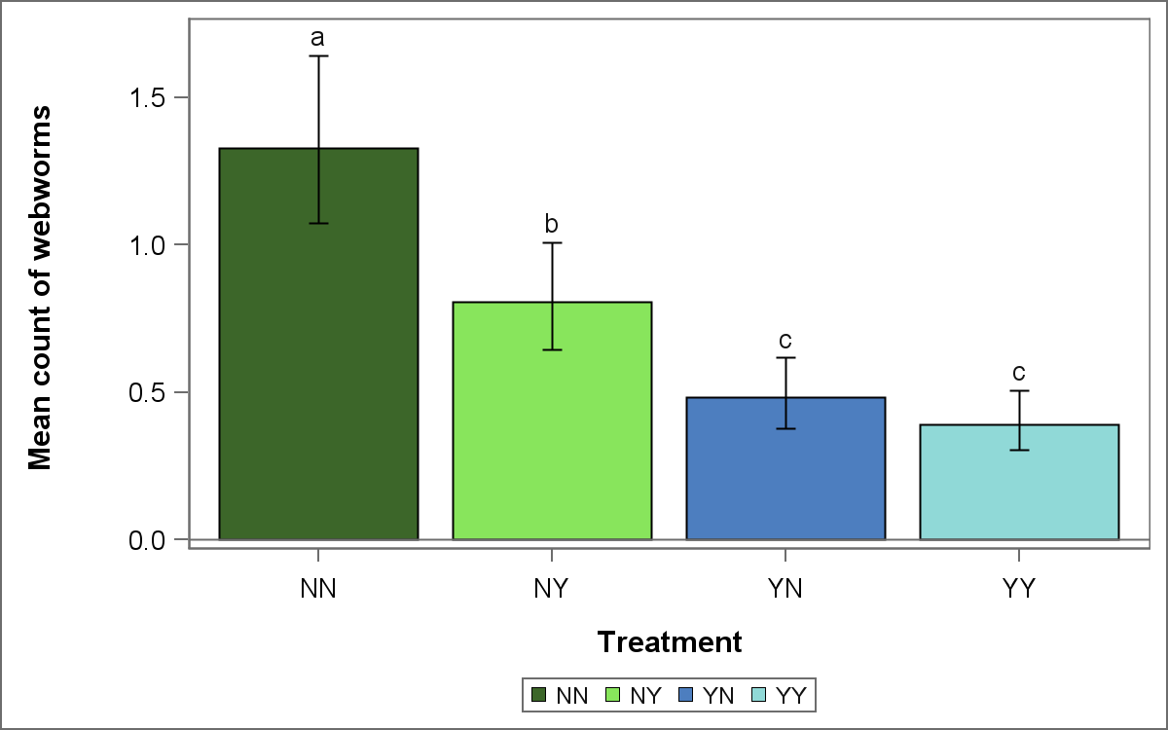
Step 8. Make graphs

Slide 28

Acknowledgment
Dr. Edzard van Santen →
Dr. Phil Hahn
Allan Busuulwa
Alex Bauer

Slide 29

Questions ?

